Slide 1



Food Wastage Analysis
View in Power BI
Last data refresh:
09/05/2025 13:42:51 UTC
Downloaded at:
09/05/2025 13:44:27 UTC

Slide 2
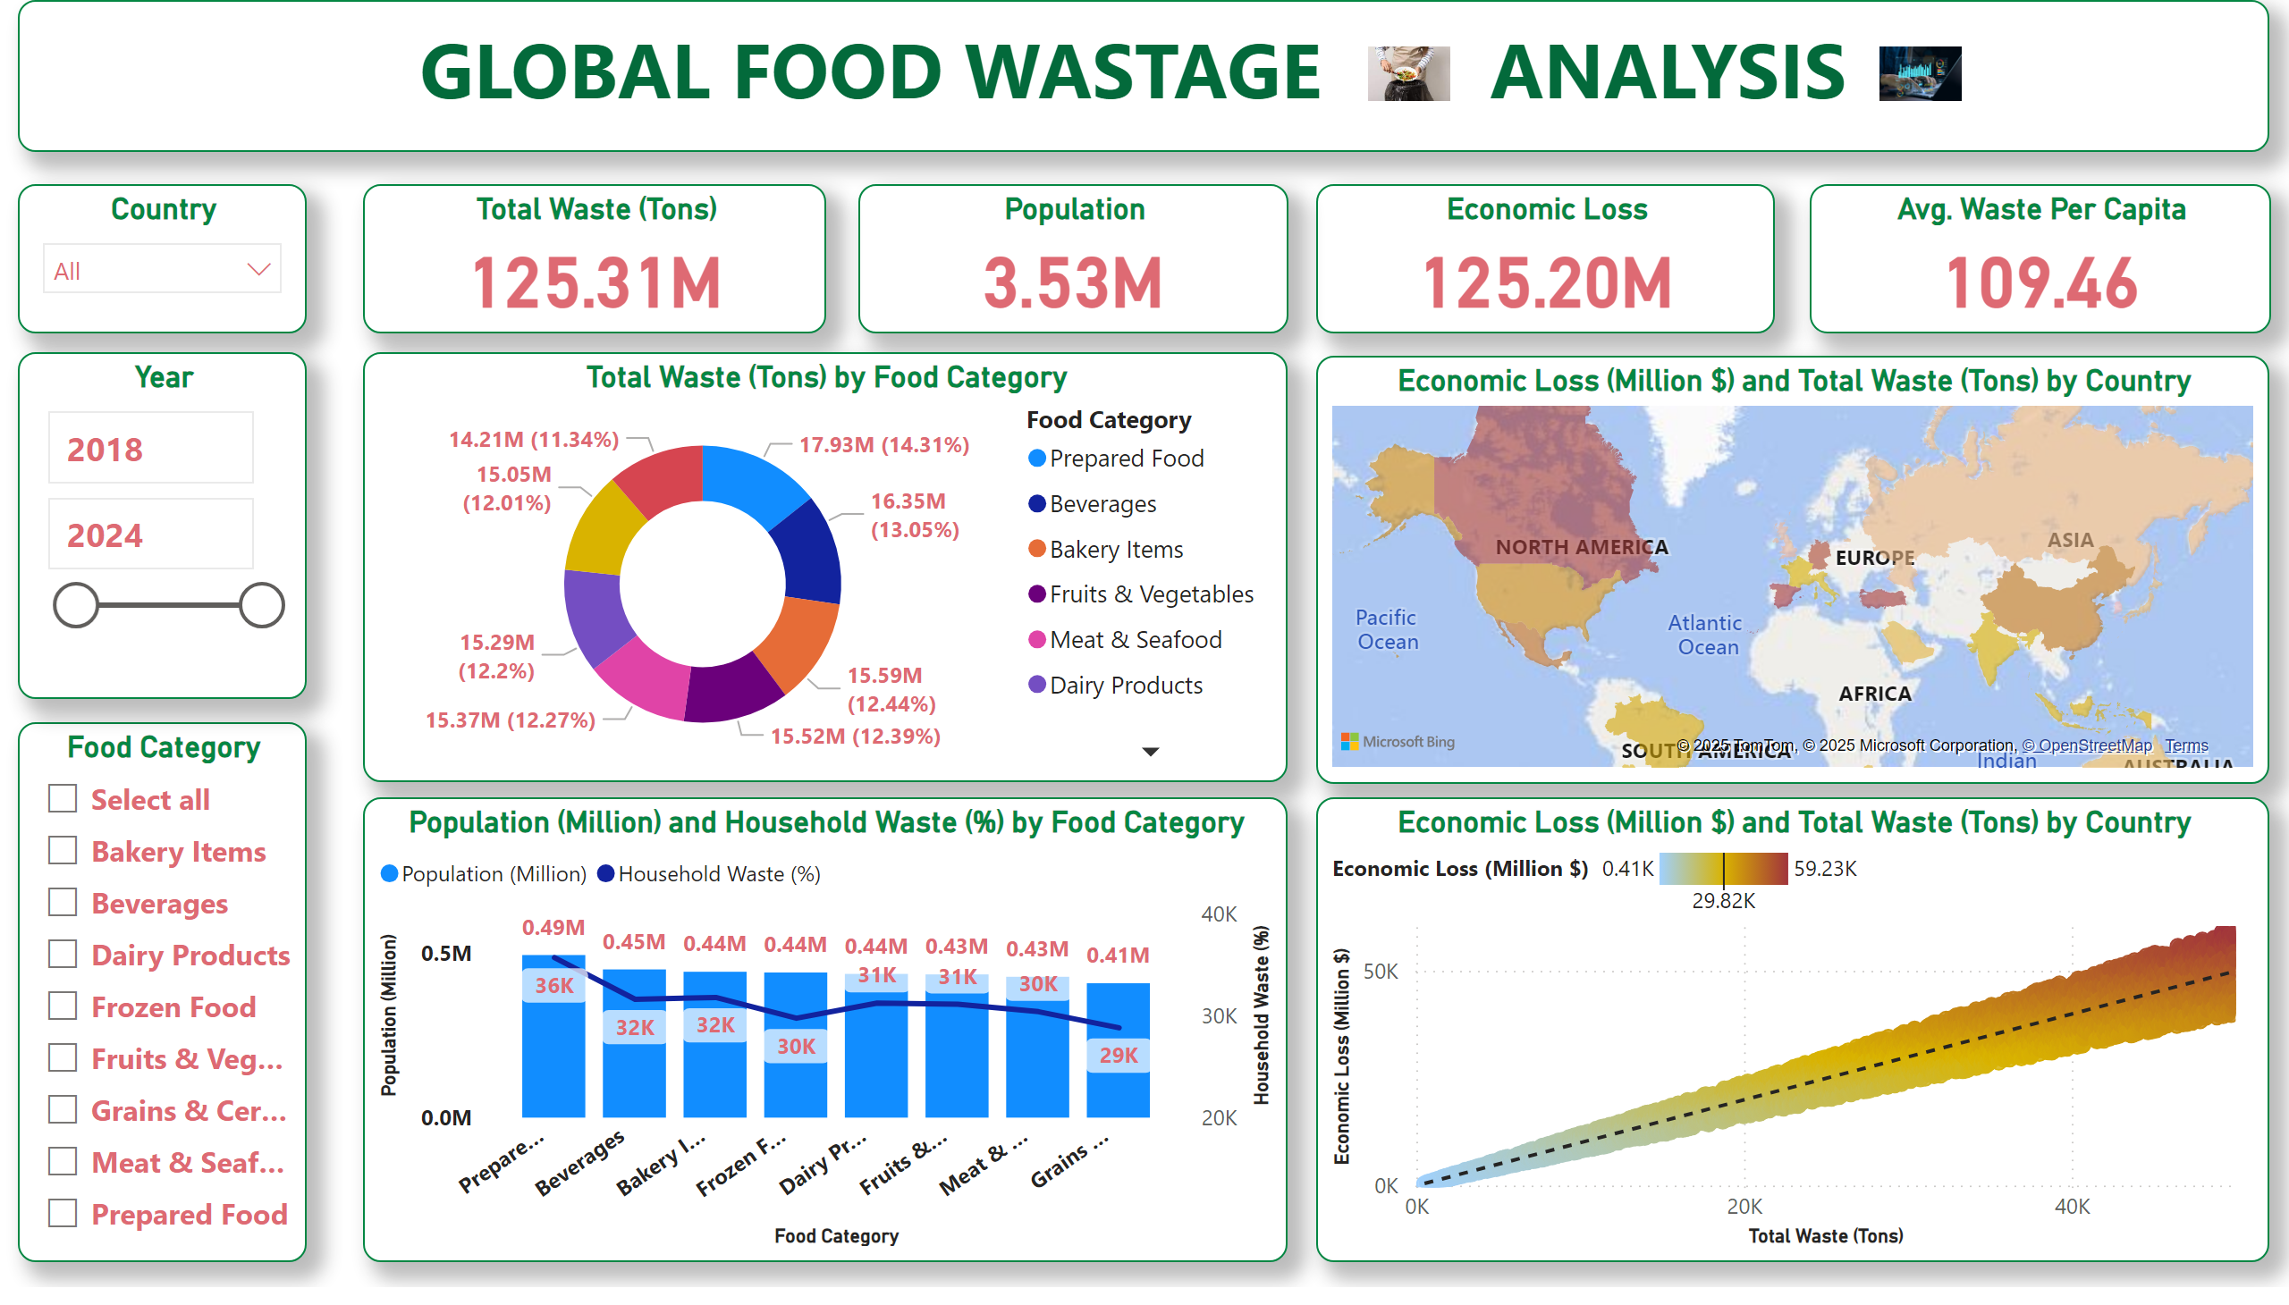
Page 1
Notes:
textbox
No alt text provided
image
No alt text provided
image
No alt text provided
Avg. Waste Per Capita
No alt text provided
Economic Loss
No alt text provided
Population
No alt text provided
Total Waste (Tons)
No alt text provided
Food Category
No alt text provided
Country
No alt text provided
Year
No alt text provided
Total Waste (Tons) by Food Category
No alt text provided
Population (Million) and Household Waste (%) by Food Category
No alt text provided
Economic Loss (Million $) and Total Waste (Tons) by Country
No alt text provided
Economic Loss (Million $) and Total Waste (Tons) by Country
No alt text provided

